Slide 1





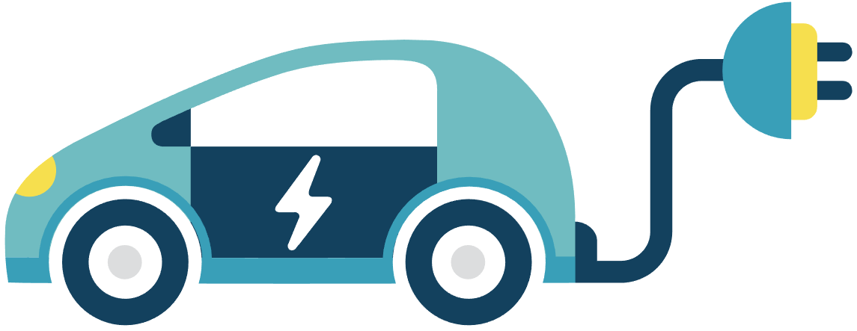
Sidd
Raman pal
Mohit Vidhani
Siddhartha Jadon

Slide 2

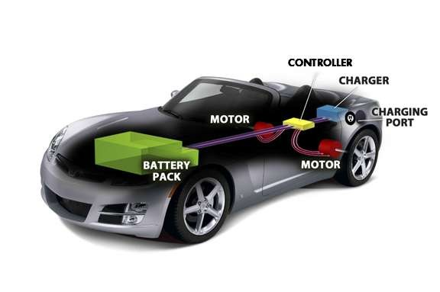
Electric vehicles
An Electric vehicle is an automobile that is propelled by one or more electric motors, using electrical energy stored in energy storage device.
Controller
Electric Motor
Battery

Slide 3
Problem:-
What kind of interface can EESL built to increase the use of public charging stations?
Expection: -
A solution where electric vehicles can communicate with charging stations to provide automated information to EVS users in order to identify and reach out to the nearest charging station.

Slide 4

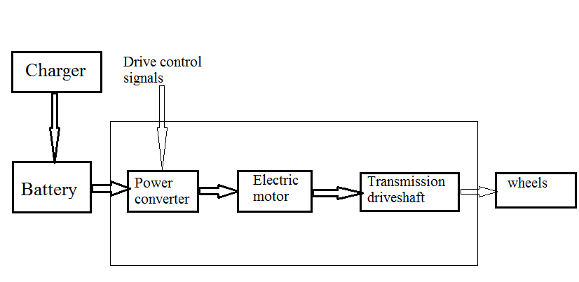
Block diagram
An Electric vehicle system

Slide 5

Heating Issue:-
hhhh
Freon Gas (CFC)
Freon gas is a system of coils and compressors in your AC unit. The AC compresses the R-22 gas, making it very hot.
Nitrogen
Nitrogen gas is an industrial gas produced by the fractional distillation of liquid air or by mechanical

Slide 6

Cold Issue:-
Block Heater
Block heater warms an engine to increase the chances that the engine will start as well as warm up the vehicle faster than it normally would in extremely cold weather.

Slide 7

How to Reduce Timing for Battery
A start-up has developed a novel battery which it claims can charge electric vehicles (EVs) in under 15 minutes, making them more affordable for the end users.
Corporate semi-quick charging: 1¼ hours
Companies can install more powerful connections for recharging their fleets. They also generally have three-phase circuits, which greatly reduces the charging time compared to recharging at home.

Slide 8
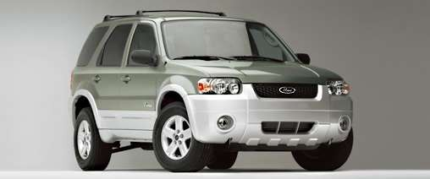
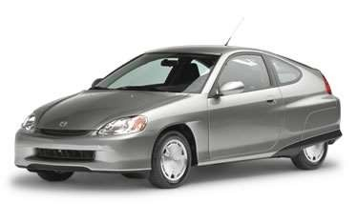
Commercial vehicles
Mahindra e2oPlus.
Atom Motors, Stellar.
Mahindra e-Verito.
Tata Tigor Electric.
Mahindra e-KUV 100
Tata Tiago Electric.

Slide 9
Advantage of EV
Provide more services at charging station like for long journeys food, restaurants, air pumps, toilets.
Make use of charging station as user friendly as possible
More charging station on frequent routes
Provide quick technical support in case of problems direct to EESL.
Easy car loans to for buying of e-vehicles
Colaboration with good car insurance companies to encourage buying e-vehicles.

Slide 10
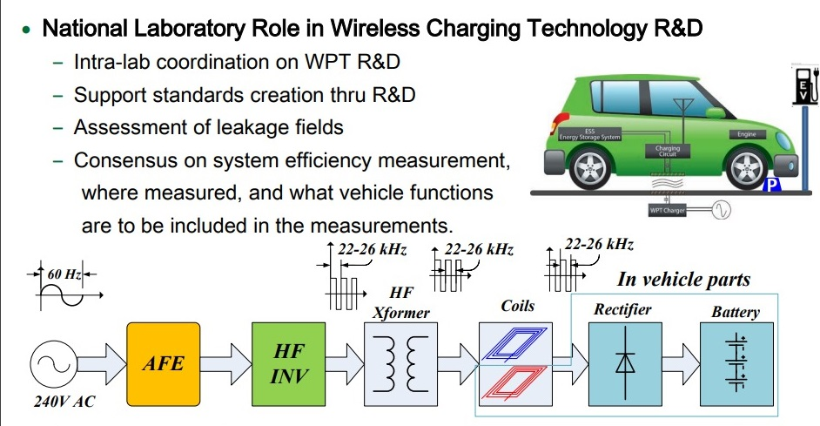
Wireless charging in EV

Slide 11
Commercial vehicles
Mahindra e2oPlus.
Atom Motors, Stellar.
Mahindra e-Verito.
Tata Tigor Electric.
Mahindra e-KUV 100
Tata Tiago Electric.

Slide 12
Conclusion
Using the concept electric vehicle cars results in better efficiency and also saves a lot of fuel in today’s fuel deficit world.
A electric vehicle gives a solution to all the problems to some extent.
One can surely conclude that this concept will follow with even better efficiency & conservation rate

